Slide 1
Lecture 12
Programme to ensure self-regulation and Health

Slide 2


Slide 3
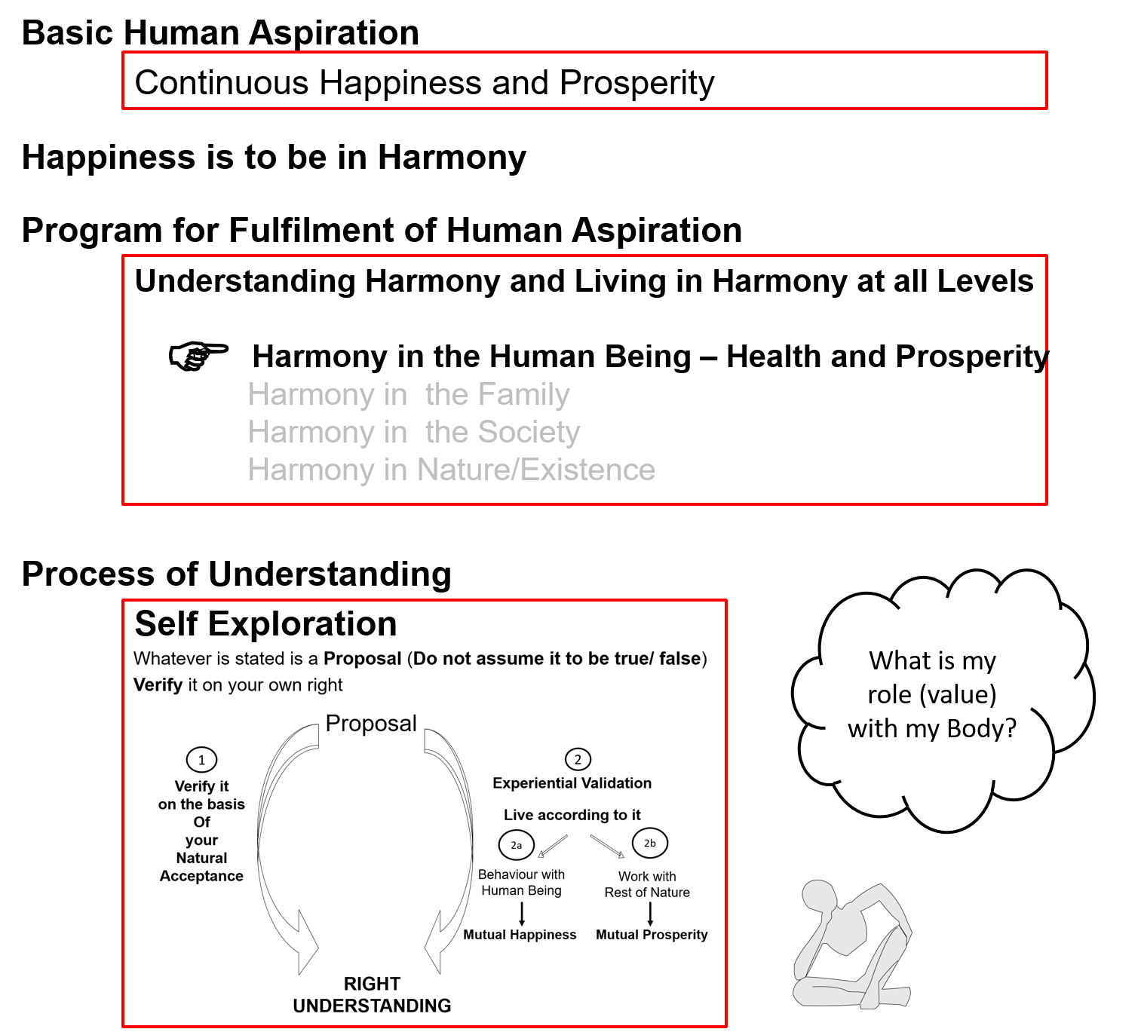

Slide 4
Human Being Ekkuo | Self eSa | Body “kjhj
Need vko';drk | Happiness (e.g. Respect) lq[k ¼tSls lEeku½ | Physical Facility (e.g. Food) lqfo/kk ¼tSls Hkkstu½
In Time dky esa | Continuous fujUrj | Temporary lkef;d
In Quantity ek=k esa | Qualitative (is Feeling) xq.kkRed ¼Hkko gS½ | Quantitative (Required in Limited Quantity) Ekk=kRed ¼lhfer ek=k esa½
Fulfilled By iwfrZ ds fy, | Right Understanding & Right Feeling lgh le>] lgh Hkko | Physio-chemical Things HkkSfrd&jklk;fud oLrq
Activity fØ;k | Desire, Thought, Expectation… bPNk] fopkj] vk”kk--- | Eating, Walking… [kkuk] pyuk---
In Time dky esa | Continuous fujUrj | Temporary lkef;d
Response | Knowing, Assuming, Recognising, Fulfilling tkuuk] ekuuk] igpkuuk] fuokZg djuk | Recognising, Fulfilling igpkuuk] fuokZg djuk
 | Consciousness pSrU; | Material tM+
Co-existence
lgvfLrRo

Slide 5
Human Being Ekkuo | Self (I) eSa | Body “kjhj
Need vko';drk | Happiness (e.g. Respect) lq[k ¼tSls lEeku½ | Physical Facility (e.g. Food) lqfo/kk ¼tSls Hkkstu½
Fulfilled By iwfrZ ds fy, | Right Understanding & Right Feeling lgh le>] lgh Hkko | Physio-chemical Things HkkSfrd&jklk;fud oLrq
 | Feeling of Self-regulation (संयम) | Health
 | Feeling of responsibility toward the body – for Nurturing, Protection and Right Utilization of the Body | The Body acts according to the Self Parts of the body are in harmony (in order)
Co-existence
lgvfLrRo
Notes:
Who is the observer? Self or body?
Can you see that you are always active “imagination” is always going on

Slide 6
Feeling of Self-regulation → Program for it → Health in the Body
The Body is an orderly system (a harmony). It has definite conduct.
The cells in the body work together, in harmony with each other, participate in the larger order to form tissues, organs and organ systems…
I (Self) have to ensure the continuity of that harmony (at least not disturb it).
If I have a feeling of responsibility toward the body, I do what is required for fulfilling that responsibility.
This will ensure health in the Body

Slide 7
Program
(A) For Staying Healthy
  1 Intake and Routine (Lifestyle)
  2 Labour and Exercise
  3 Postures for regulating internal & external body organs and
  Regulated Breathing
  4 Medicine and Treatment
(B) For bringing body back to harmony from temporary disharmony
(C) Dependence on drug / machine to perform a body function
1a. Intake includes air, water, sunlight, food (food is nutritious, digestible & tasty and waste is excretable), all intake through our senses (sound, sight, smell etc)
1b. Rising time, sleeping time, eating time…
2a. Outcome of labour is production of physical facility
2b. No physical facility is produced by exercise

Slide 8
Intake
Intake includes all that we take in through our sense organs – air, water, sunlight, food…
Along with this, we also have feelings and thoughts in response to outside events/circumstances etc.
To maintain health:
  Intake of food that is not only tasty but also nutritious and digestible and rich in fibre (making its waste easily and efficiently excretable)
  Intake of water in the right amount and at the right time
  Daily exposure to fresh air and sunlight
  Awareness of choice of food as above and how much to eat (sensation of fullness)
  Avoiding distractions by other intake through our senses and the thoughts they generate in us, especially while eating.
  e.g. what we are seeing (focusing on the meal or watching TV, playing games on the mobile etc) and hearing/being a part of (?arguments with others)

Slide 9
Routine
The Circadian Rhythm
Body response to the solar cycle
(Understanding this helps in setting up a harmonious daily routine)
The Rhythm of Seasons
Body response to the seasons
Availability of complementary plants in various seasons
(Understanding this helps in deciding appropriate seasonal intake, necessary protection of the Body and setting up a harmonious seasonal routine)
The Body lifecycle Rhythm
Childhood – growth (cuf)
Youth (pitta)
Old age (vata)
(Understanding this helps in deciding a harmonious lifestyle for each stage of life)

Slide 10
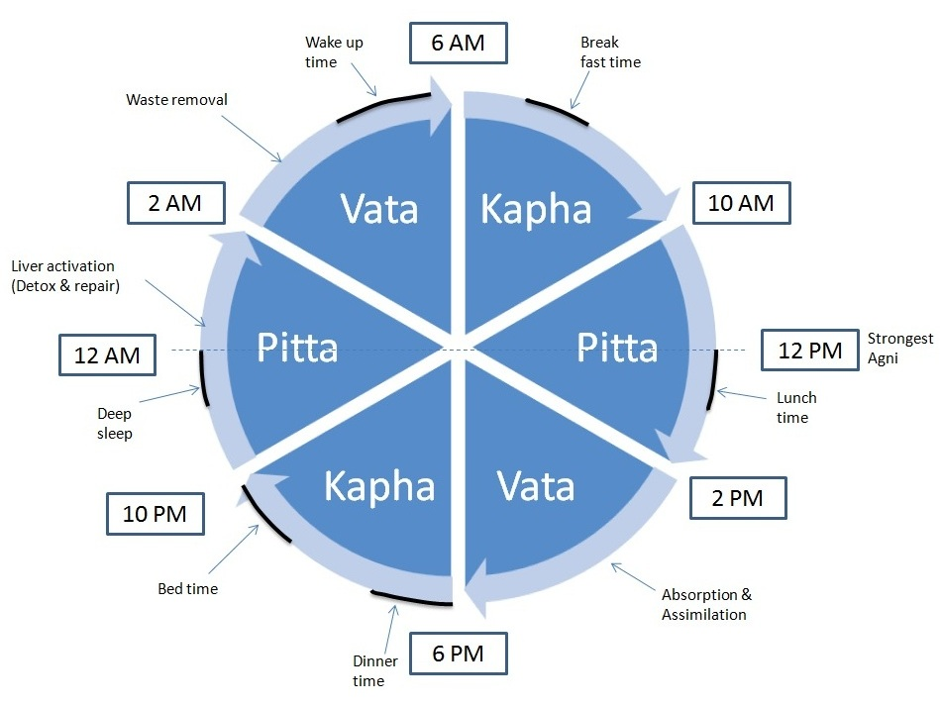
Routine. Daily Routine – in Harmony with Nature (Circadian Rhythm)

Slide 11
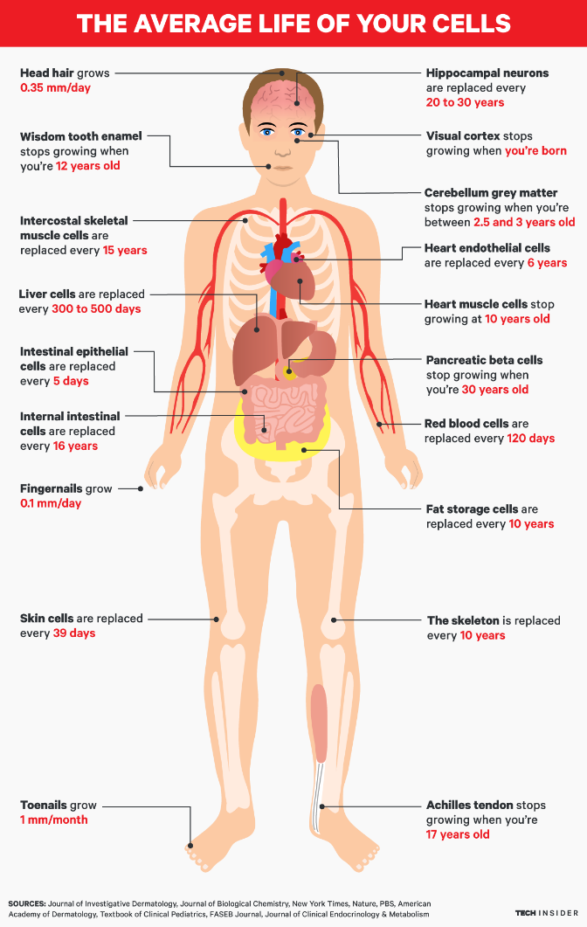

Slide 12
Understanding the Body
(day 1 doc)
The Body – from a single cell to a huge harmony of trillions of cells working together…
  Homeostatis
  Principle of regeneration of Body tissues
  Basic life processes
  Organ systems
A healthy Body is naturally a harmony in itself and is in harmony with the natural environment
It is the Self that has to decide how to stay in harmony or otherwise by way of the lifestyle (intake, routine etc.)

Slide 13
Basic Principles Governing Health of Body
(day 3 doc)
Principle of accumulation
The body is an accumulation of intake
(Understanding this helps in deciding intake)

Slide 14
Basic Principles Governing Health of Body
The Circadian Rhythm
Body response to the solar cycle
(Understanding this helps in setting up a harmonious daily routine)
The Rhythm of Seasons
Body response to the seasons
Availability of complementary plants in various seasons
(Understanding this helps in deciding appropriate seasonal intake, necessary protection of the Body and setting up a harmonious seasonal routine)
The Body lifecycle Rhythm
Childhood – growth (cuf)
Youth (pitta)
Old age (vata)
(Understanding this helps in deciding a harmonious lifestyle for each stage of life)

Slide 15
Basic Principles Governing Health (cont.)
Principle of similarity and dissimilarity
Body type
(Understanding this helps in deciding intake, routine etc. for your body type)
Principle of availability of information from Body
The Self only has to be aware, read it and act
(Understanding this helps in reading and responding to signals from the Body)
Principles related to influence of the state of Self on health of Body(Understanding this will influence the way you look at health:
Holistic Human Health = health of Self + health of Body + health of the environment
Environment = family, society, nature/existence)

Slide 16
Indicators of Health of Body
(day 3 p 2)
Add flexibility of the Body

Slide 17
Labour Exercise
Ensure adequate movement of the Body + production of physical facility
Examples:
  Sweeping and swabbing your room / house / hostel
  Kitchen gardening
  Cycling to your college and back…
Ensure adequate movement of the Body
Examples:
  Jogging outdoors
  Weight training in a gym
  Exercise cycling in a gym
  Recreational cycling outdoors

Slide 18
Postures Breathing
Postures for regulating internal and external body organs
Example: Yoga
Regulated Breathing
Example: Pranayam

Slide 19
Medicine
Treatment
For bringing body back to harmony from temporary disharmony
Examples:
  Home remedies
  Integrated systems of medicine
Using a drug / machine to perform a body function (dependence)
Examples:
  Insulin
  Dialysis
  Ventilator

Slide 20
Program – Priority
(A) For Staying Healthy
1a
  1 Intake and Routine (Lifestyle)
  2 Labour and Exercise
  3 Postures for regulating internal & external body organs and
  Regulated Breathing
  4 Medicine and Treatment
1
1b
2
(B) For bringing body back to harmony from temporary disharmony
3
(C) Dependence on drug / machine to perform a body function
1a. Intake includes air, water, sunlight, food (food is nutritious, digestible & tasty and waste is excretable), all intake through our senses (sound, sight, smell etc)
1b. Rising time, sleeping time, eating time…
2a. Outcome of labour is production of physical facility
2b. No physical facility is produced by exercise

Slide 21
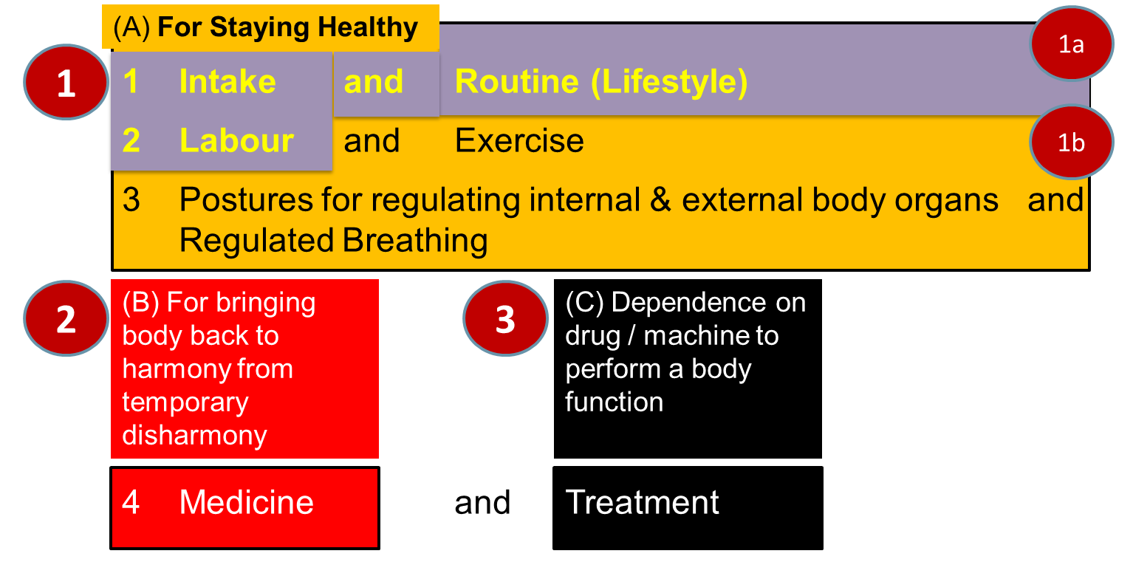
Sum Up
The Self and the Body are in Harmony when there is a feeling of Self-regulation in the Self and Health in the Body
  Self-regulation = Feeling of responsibility toward the body – for Nurturing, Protection and Right Utilization of the Body
  Health = The body acts according to Self and parts of the body are in harmony (in order)
Program

Slide 22
Self Reflection

Slide 23
Self Reflection
Do you have a feeling of Self-regulation (responsibility toward your body)? – continuous?
Is your body healthy?

Slide 24
Key Points
Programme to ensure self-regulation and Health

Slide 26
Human Being Ekkuo | Self eSa | Body “kjhj
Need vko';drk | Happiness (e.g. Respect) lq[k ¼tSls lEeku½ | Physical Facility (e.g. Food) lqfo/kk ¼tSls Hkkstu½
In Time dky esa | Continuous fujUrj | Temporary lkef;d
In Quantity ek=k esa | Qualitative (is Feeling) xq.kkRed ¼Hkko gS½ | Quantitative (Required in Limited Quantity) Ekk=kRed ¼lhfer ek=k esa½
Fulfilled By iwfrZ ds fy, | Right Understanding & Right Feeling lgh le>] lgh Hkko | Physio-chemical Things HkkSfrd&jklk;fud oLrq
Activity fØ;k | Desire, Thought, Expectation… bPNk] fopkj] vk”kk--- | Eating, Walking… [kkuk] pyuk---
In Time dky esa | Continuous fujUrj | Temporary lkef;d
Response | Knowing, Assuming, Recognising, Fulfilling tkuuk] ekuuk] igpkuuk] fuokZg djuk | Recognising, Fulfilling igpkuuk] fuokZg djuk
 | Consciousness pSrU; | Material tM+
Co-existence
lgvfLrRo

Slide 27
Human Being Ekkuo | Self (I) eSa | Body “kjhj
Need vko';drk | Happiness (e.g. Respect) lq[k ¼tSls lEeku½ | Physical Facility (e.g. Food) lqfo/kk ¼tSls Hkkstu½
Fulfilled By iwfrZ ds fy, | Right Understanding & Right Feeling lgh le>] lgh Hkko | Physio-chemical Things HkkSfrd&jklk;fud oLrq
 | Feeling of Self-regulation (संयम) | Health
 | Feeling of responsibility toward the body – for Nurturing, Protection and Right Utilization of the Body | The Body acts according to the Self Parts of the body are in harmony (in order)
Co-existence
lgvfLrRo
Notes:
Who is the observer? Self or body?
Can you see that you are always active “imagination” is always going on

Slide 28
Program – Priority
(A) For Staying Healthy
1a
  1 Intake and Routine (Lifestyle)
  2 Labour and Exercise
  3 Postures for regulating internal & external body organs and
  Regulated Breathing
  4 Medicine and Treatment
1
1b
2
(B) For bringing body back to harmony from temporary disharmony
3
(C) Dependence on drug / machine to perform a body function
1a. Intake includes air, water, sunlight, food (food is nutritious, digestible & tasty and waste is excretable), all intake through our senses (sound, sight, smell etc)
1b. Rising time, sleeping time, eating time…
2a. Outcome of labour is production of physical facility
2b. No physical facility is produced by exercise

Slide 29
FAQs for Lecture 12
Programme to ensure self-regulation and Health

Slide 30
Question(s): Response
Is self-regulation same as self control or self restraint?
  Self-regulation is defined as- Feeling of responsibility toward the body – for Nurturing, Protection and Right Utilization of the Body.
  With this feeling of responsibility, the self takes care of the body.
  When we talk about self control or self restraint, the sense we get is that the self is controlling things related to body with a feeling of fear or of opposition.
  For example, with feeling of responsibility, I eat food which is nutritious and tasty, but, I don’t eat food which is tasty but, not nutritious. This happens in a natural manner. On the other hand, if I don’t have this feeling of responsibility, and I want to eat food which is tasty but not nutritious, however, due to fear of falling sick, I am not eating that food, then, this is self restraining. This doesn’t happens in a natural manner and somewhere I have a feeling of unhappiness.

Slide 31
Question(s): Response
The body has an ageing process and with age diseases start appearing. Also there are viruses etc. Will a person with right understanding and feeling of self-regulation not have such diseases?
Is health of body also a human value?
  In general, a person with right understanding and feeling of self-regulation will be able to maintain the health of his body and not fall sick. However, the aging of the body will certainly have its effect, but, he will be able to see this and plan his lifestyle accordingly. Similarly, tmhe effect of environment such as extreme weather or even viruses can effect the health of his body. But,, he will handle this by taking preventive measures or by doing the necessary detoxification or taking the suitable medicine, so that the body can recover its health.
  Feeling of Self-regulation is value in the self, which expresses itself as health in the body. This can be seen as the feeling of care towards the body.

Slide 32
Question(s): Response
What would be right utilisation of a healthy Body?
The Self is central to human existence
The purpose Self is to develop completeness of
  Right understanding, i.e. understanding of harmony at all levels of being – Truth
  Right feeling, i.e. feeling of harmony – Love
  Right thought, i.e. thought of how to live in harmony – Compassion
The Body is used as an instrument by the Self for interacting with the world outside:
  Behaviour with human being
  Work with rest of nature
Physical facility is required for the Body – to nurture it, protect it and in the process of right utilisation of the Body

Slide 33
Question(s): Response
If body is unhealthy, will the Self be still happy?
How do you distinguish between mental health and physical health?
As we have discussed, happiness in the self can be unsured through right understanding and right feelings which has to do with the state of the self and not state of the body. However, if the body is unhealthy, it will be a matter of concern, and the person with right understanding will do whatever is necessary for recovering the health of the body, without getting unhappy over it.
Mental health has to with disharmony at the level of self, but, Physical health has to with disharmony at the level of Physical body.

Slide 34
Question(s): Response
Why is medicine and treatment kept separate – aren’t they similar?
As discussed in the session,
medicine is used-r bringing body back to ary For bringing body back to harmony from temporary disharmony
this can be done through Home remedies or through Integrated systems of medicine
However, Treatment has to do with
Using a drug / machine to perform a body function (dependence)
For examples, by using Insulin in case of diabetes or doing Dialysis for blood purification.

Slide 35
Question(s): Response
What will be the role of a doctor if everyone has the feeling of self-regulation?
The major role of the doctors then would be
Health education- education that will enable people to have this feeling of self-regulation and develop the competence to take care of the health of their body
To help them to take preventive measures for the effect of the environment
Provide them necessary help to recover if their body falls sick due to the effect of the environment through
      detoxification or
      medicine
Provide treatment, only in extreme cases when there is no option to take any other recourse

Slide 36
Question(s): Response
Like this doctors will become unemployed… What about their income? Today health-care is a thriving multi billion dollar industry employing millions of people! What will happen to all that?
Check what is naturally acceptable:
A system that ensures health
A system based on illness
So, we have to make effort for that kind of system. Ultimately, a system for the wellbeing of all (what NEP2020 calls and equitable and just society). People with a holistic world-view, competence and commitment may be able to work towards such a society. We will discuss this when we cover harmony in society

Slide 37
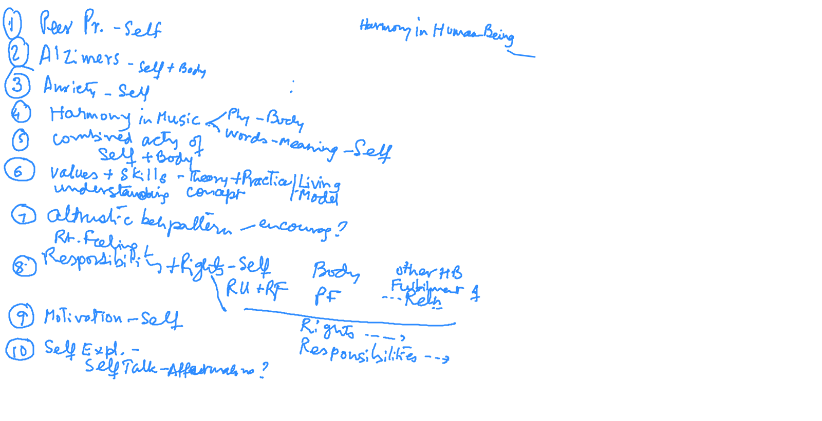
Q&A at end of Module 1 & 2 [22-01-2021]

